Slide 1
Predicting Song Popularity Using Data Mining Methods
By
Sai Vinay Teja Jakku
Harshini Daggubati

Slide 2
Problem Setting
Spotify is an application that offers online listening and streaming services in the form of music or podcasts to people around the globe. Spotify has a large collection of songs and podcasts, and users can choose to listen to any song and give the song a rating. Spotify uses these user ratings and other metrics to recommend similar songs to the user

Slide 3
Problem Definition
This project aims to do an Exploratory data analysis of the Spotify open data using Python libraries. Further, we will do visualization analysis for this dataset to understand factors like the correlation between different variables. We will use different data mining methods to predict the popularity of the song and report the prediction accuracy and errors.
We aim to find the answers to the below-proposed business questions:
What makes a song popular?
Do the valence and different factors affect the song popularity?
How important is artist and genre when it comes to determining the popularity of a song?

Slide 4
Data Source & Description
Link of data sources:
https://www.kaggle.com/vatsalmavani/spotify-dataset
The dataset contains 3 datasets called data, genre_data, and year_data. We will primarily work using these three datasets to determine which factors affect the popularity of a song. Data has in total 19 columns and more than 170,000 rows and has columns like Valence, Acousticness, and other variables like danceability and duration. The dataset contains columns like songID, year, artists, energy, liveness, etc. of the song.

Slide 5
Data Exploration
We import the dataset using the pandas library’s read_csv() function. Three datasets will be used in this project:
Data.csv: This dataset contains the Spotify song listings detail in brief. It has columnslike a songID, valence, liveness, etc.
genre_data.csv: This dataset contains the Spotify song listing and its genre. It has columns like genres, tempo, loudness, etc.
year_data.csv: This dataset contains the Spotify song listings and its release dates. It has columns like year, energy, speechiness, etc.
Used describe(), head(), info() functions to get an overview of the variables in the dataset

Slide 6
Data Preprocessing
In this step, we used the describe() function to get an idea about the mean, median of the numeric variables in the dataset. We also used the info() function to see if all the columns have the correct data type.
Changed duration of song from milliseconds to minutes for ease of computation & visualization and renamed the column to ‘duration_min’
Outcome Variable:
In this project, we aim to predict the popularity of Spotify songs and analyze how different factors affect the ratings of the song. Hence, the popularity variable will be our outcome variable. By checking the variables available with us, through domain knowledge, we can understand that the variables like id, mode will not be used for popularity prediction. Hence, we have dropped these variables from the dataset.
The final data frame has been stored in the ‘data’ data frame. And there are in total 170k+ rows. We also made sure that there are no null values in the dataset.

Slide 7
Visualizing Data
Correlation between the features
We can see strong correlation between Popularity & Year which makes sense, because a popularity of a song is highly dependent on when it's released
Loudness & energy - high correlation between these two variables is seen because its common to perceive loud songs as being high energetic music
Acousticness & energy – High correlation is seen between these two variables and similar arguments can be made about these two variables

Slide 8
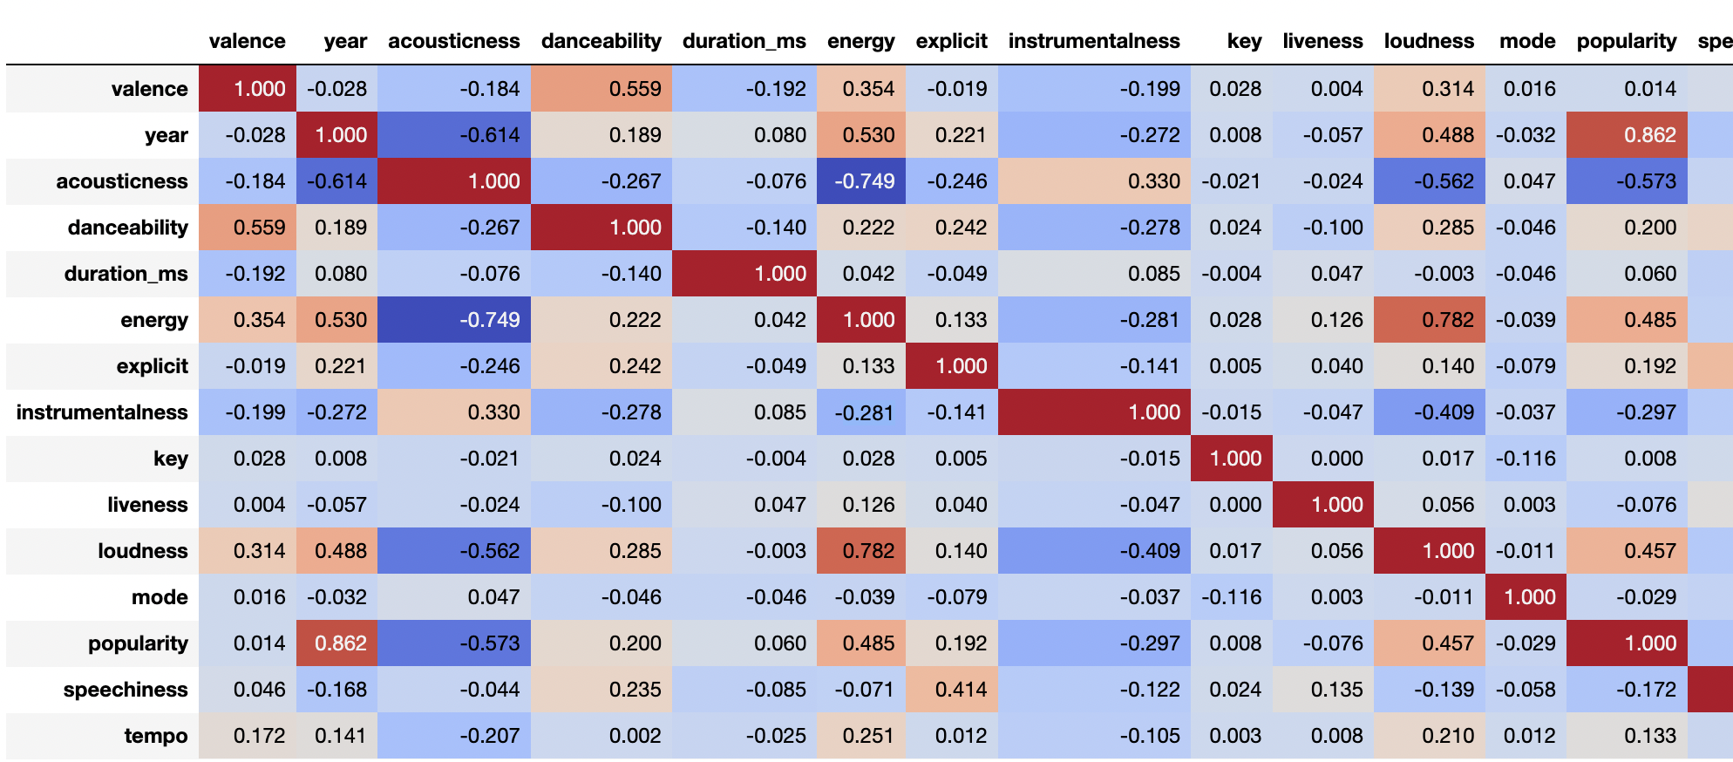
Correaltion b/w all the features

Slide 9
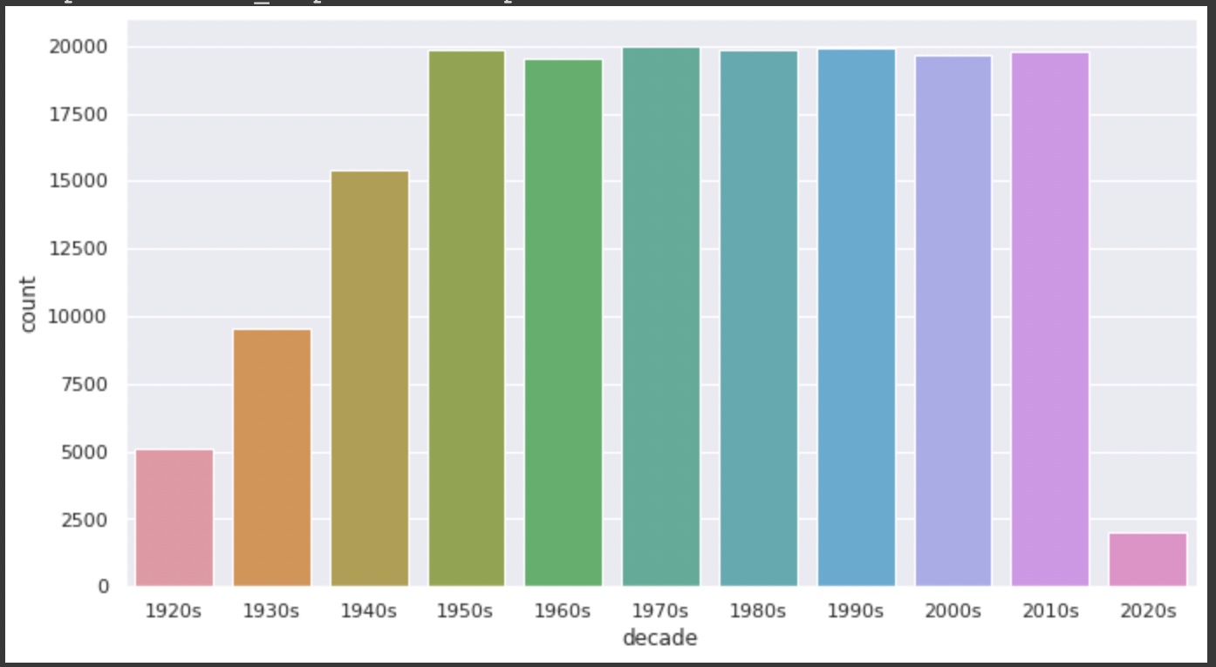
Music Over Time
Using the data grouped by year, we can understand how the overall sound of music has changed from 1921 to 2020
From this bar graph we can see that music industry has started evolving since 1950's and it could be attributed to the invention of tape recorder which happened at the end of 1940's

Slide 10
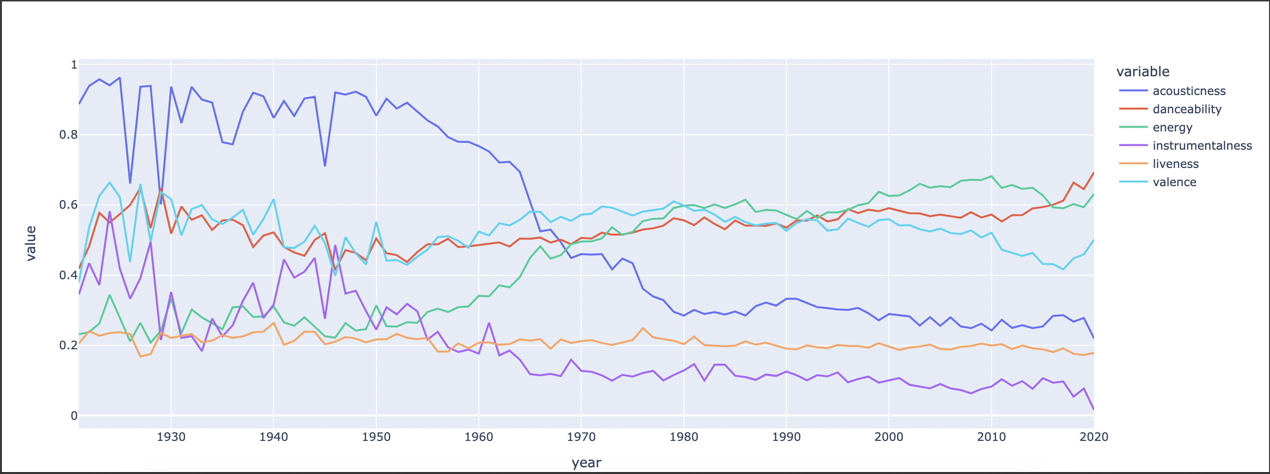
From the line graph we can see the trendline increasing for danceability and energy of the songs
And we can observe a sharp decline of trendline for acousticness and intrumentalness
This indicates there is a growing number of ‘catchy’ songs with less focus on instrumentals and acousticness of the song

Slide 11
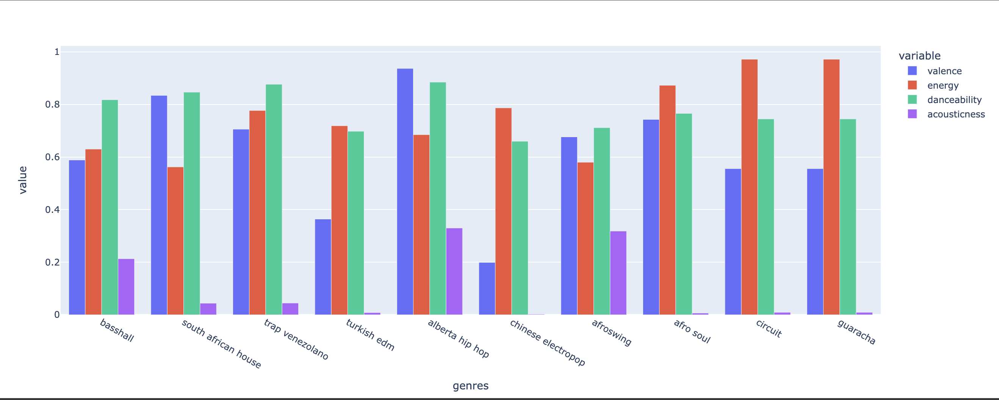
Grouped bar chart for top ten genres and its features

Slide 12
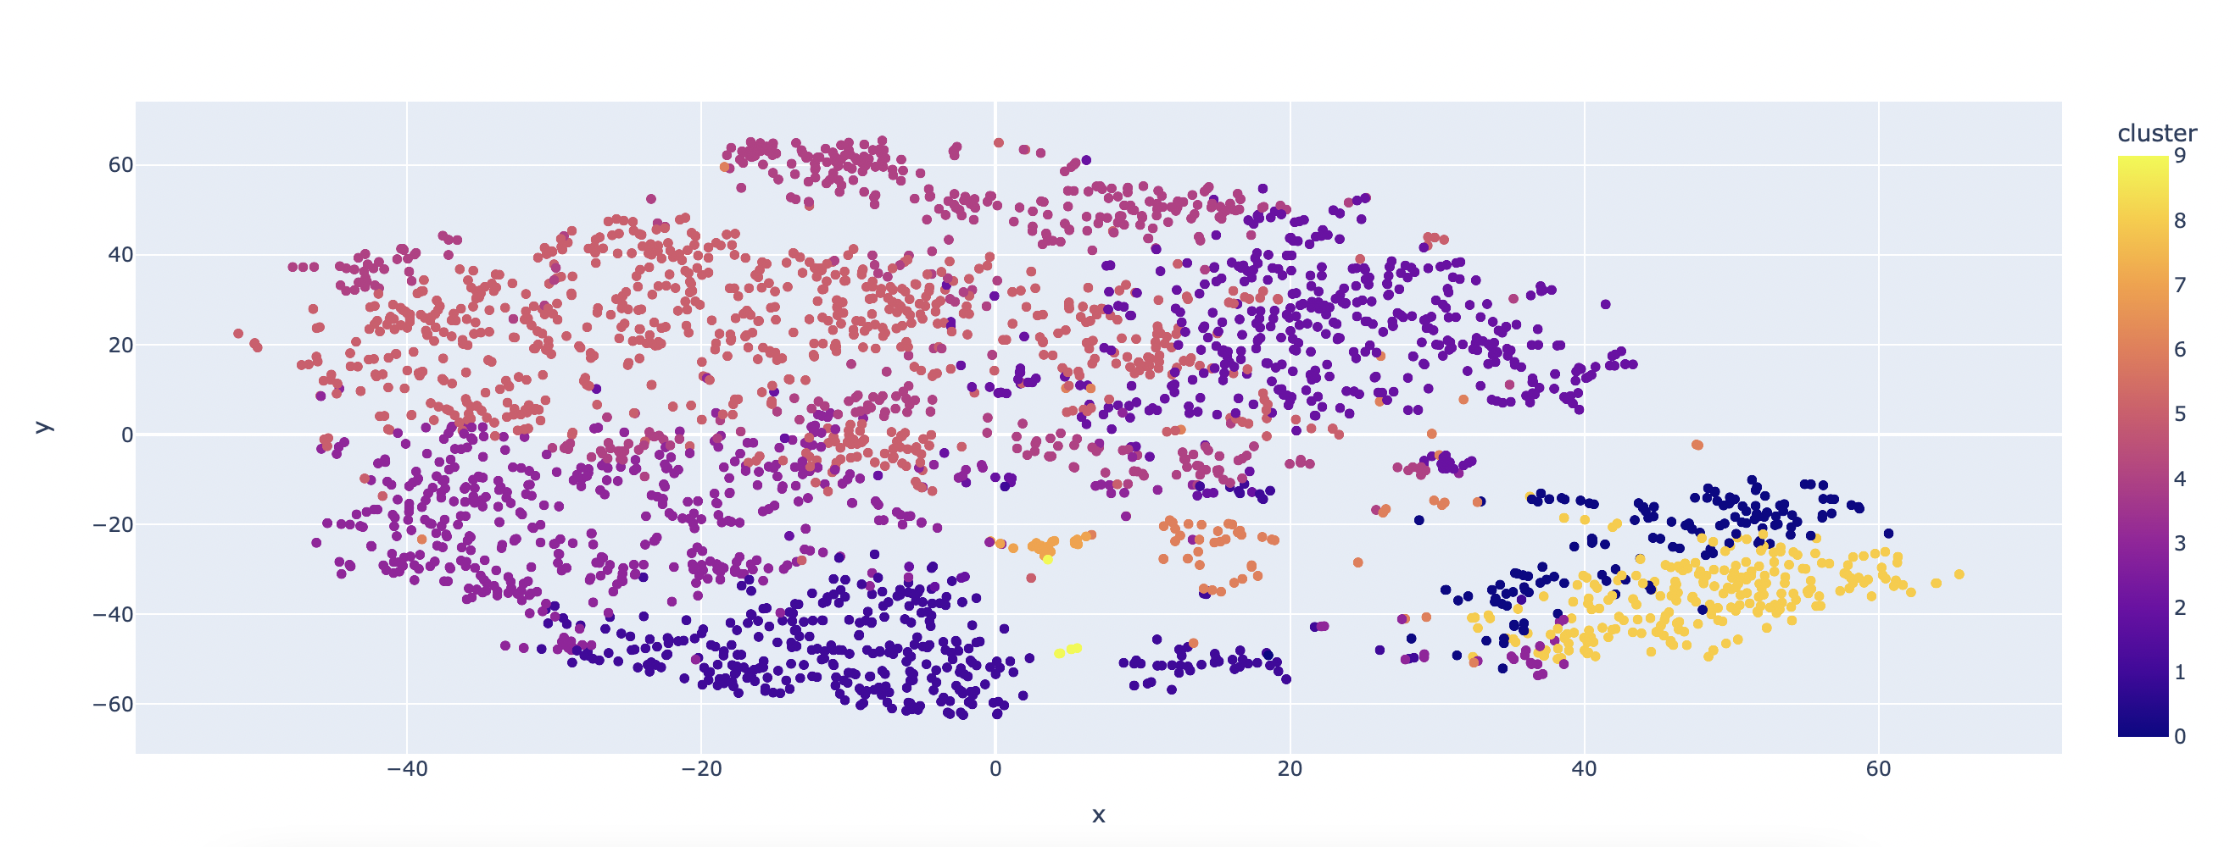
Clustering Genres with K-means algorithms

Slide 13
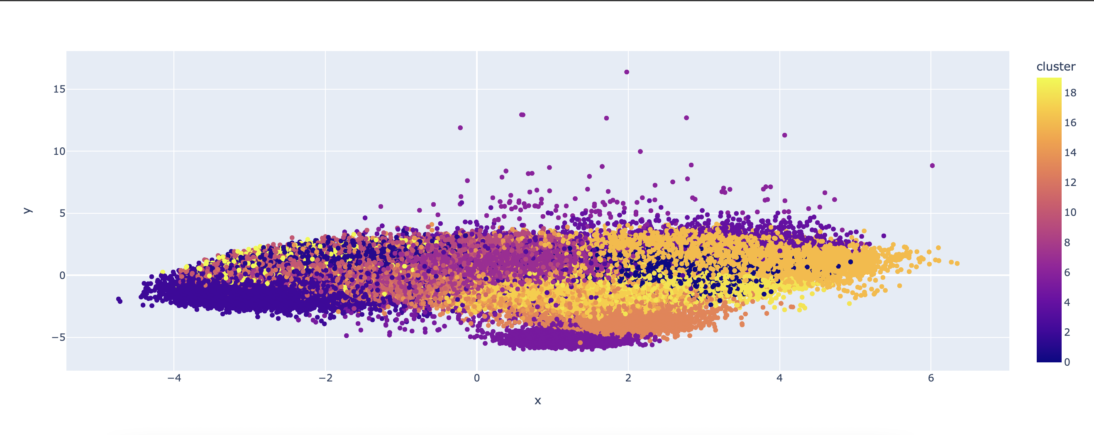
Clustering Songs with K-means model

Slide 14
Model Exploration & Implementation
We implemented the following Data Mining Models to our Dataset
Logistic Regression
Polynomial Regression
Lasso Regression Model
KNN Regression Model
Random Forest Model

Slide 15
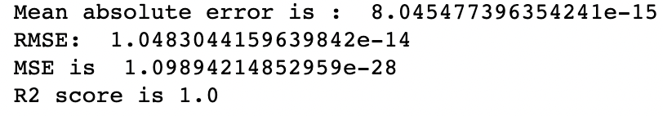
Model Performance Evaluation
Linear Regression Model
For Linear Regression, the graph fits well with the prediction, and the r2 is prefect 1 with both rmse and mae scores low. This may be the best model for our dataset.

Slide 16
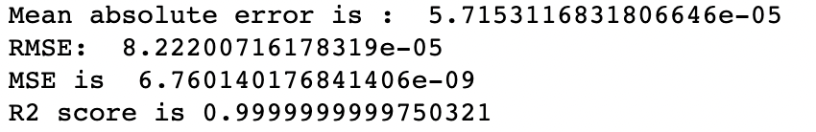
Polynomial Regression Model
For Polynomial Regression model, we can see higher rmse and mae values than that of Linear regression and high mean absolute error. For the prediction model, we will compare the scores with a graph to see which prediction model has lowest rmse.

Slide 17
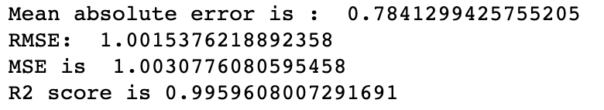
Lasso Regression Model
For Lasso Regression Model, after normalization, we can see very low scores of rmse and mae, but still higher than the above two models.

Slide 18
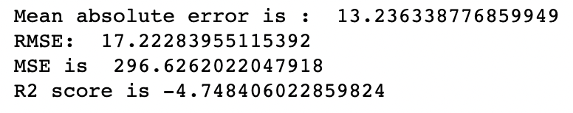
KNN Regression Model
For KNN Regression Model, we determined the optimal no of K using rmse scores and evaluated the model on this K. We got high rmse and mae scores compared to the above models.

Slide 19
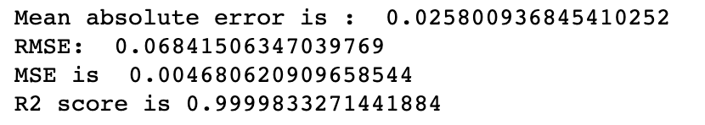
Random Forest Regression Model
For Random Forest Regression Model, we can see very low values of rmse and mae, but not as low as Linear and Polynomial regression models. This could be also the result of overfitting which is common with the model.

Slide 20
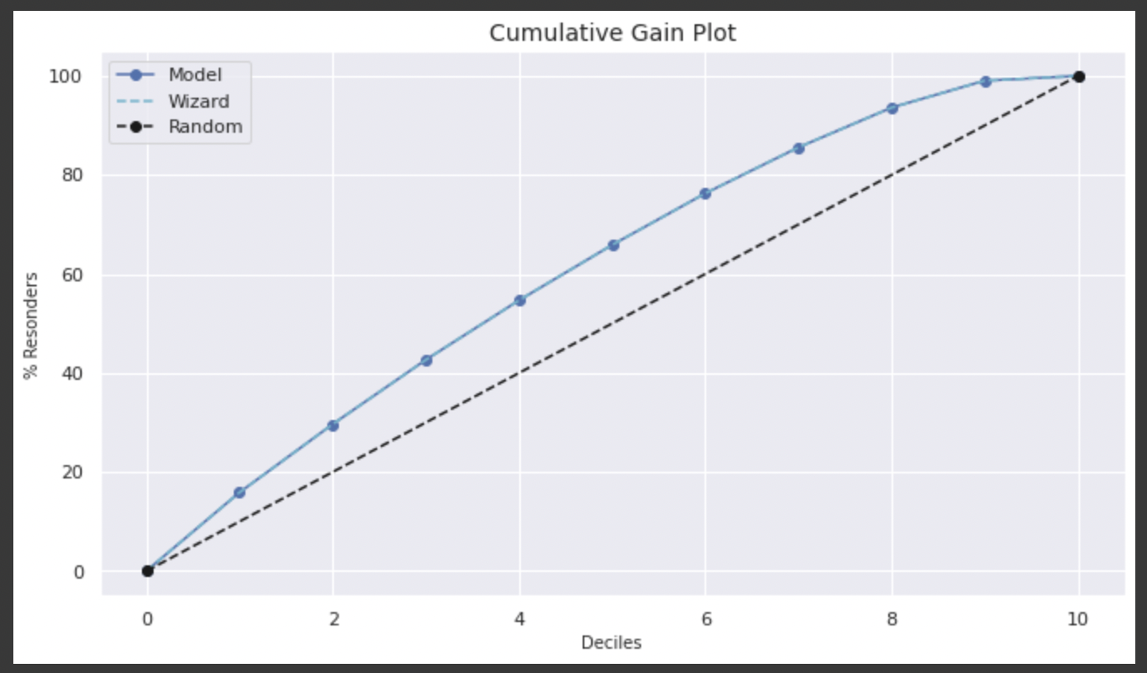
Linear Regression

Slide 21
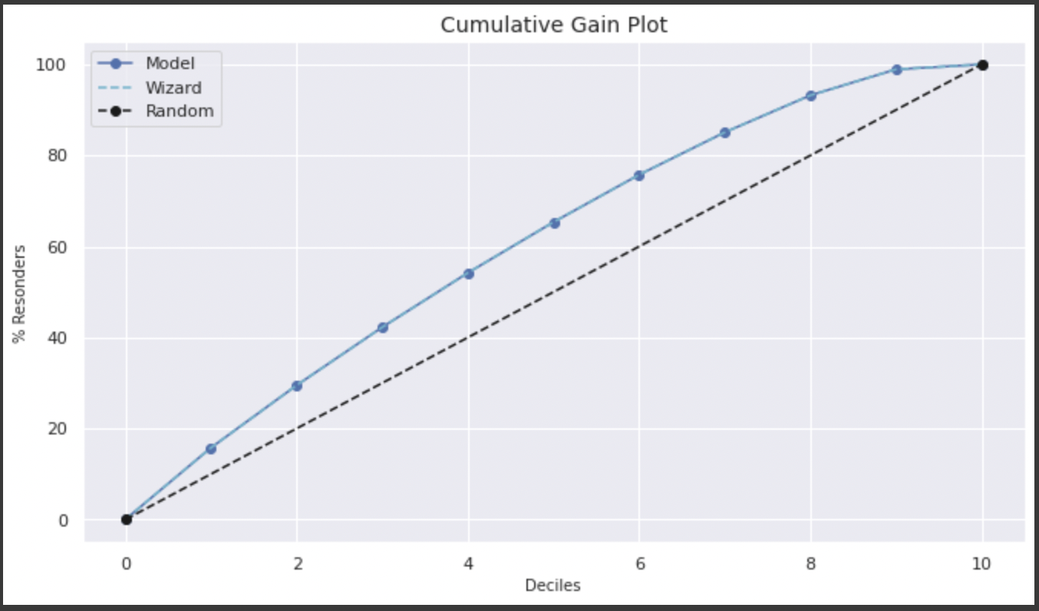
Polynomial Regression

Slide 22
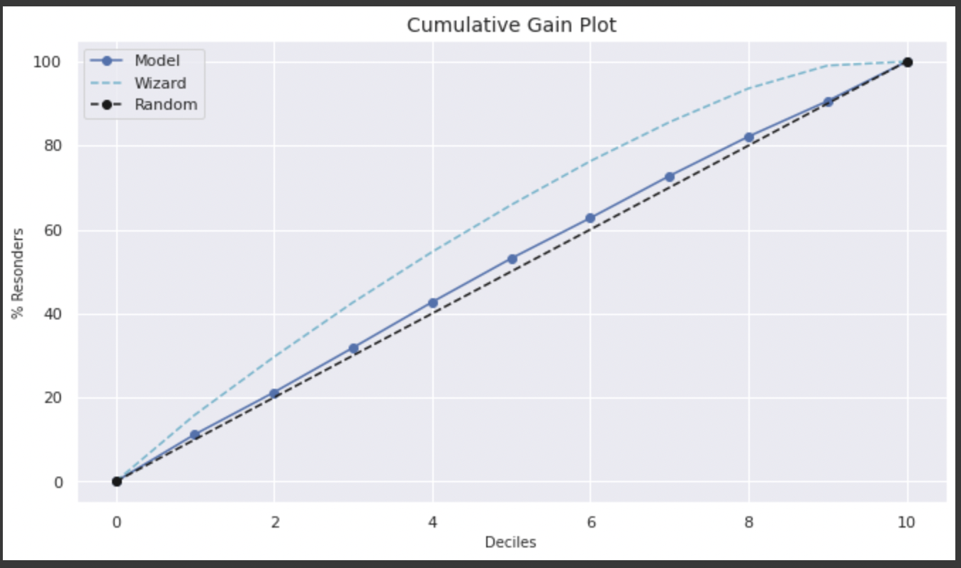
KNN Regression

Slide 23
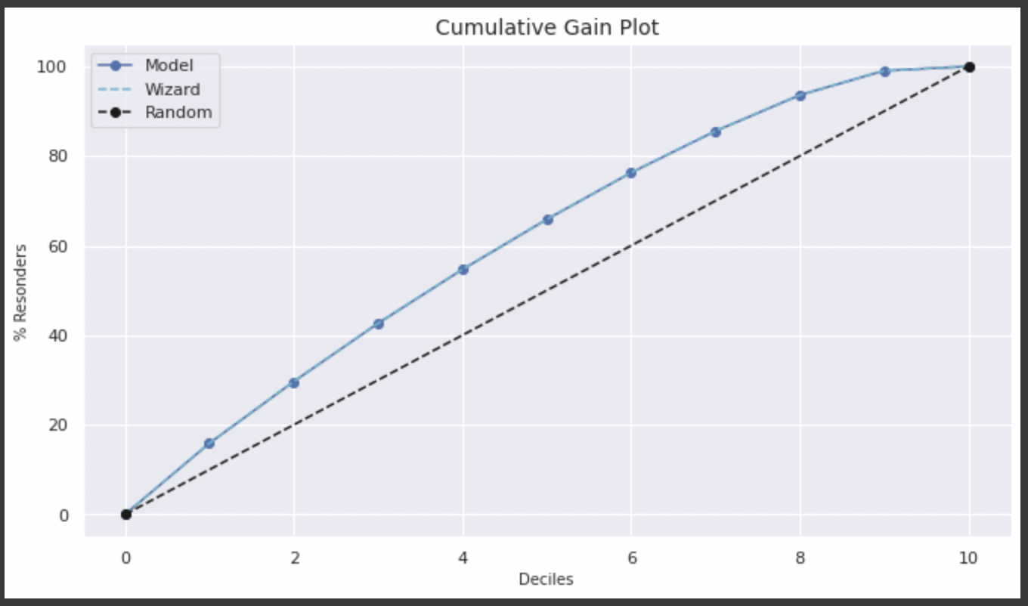
Lasso Regression

Slide 24
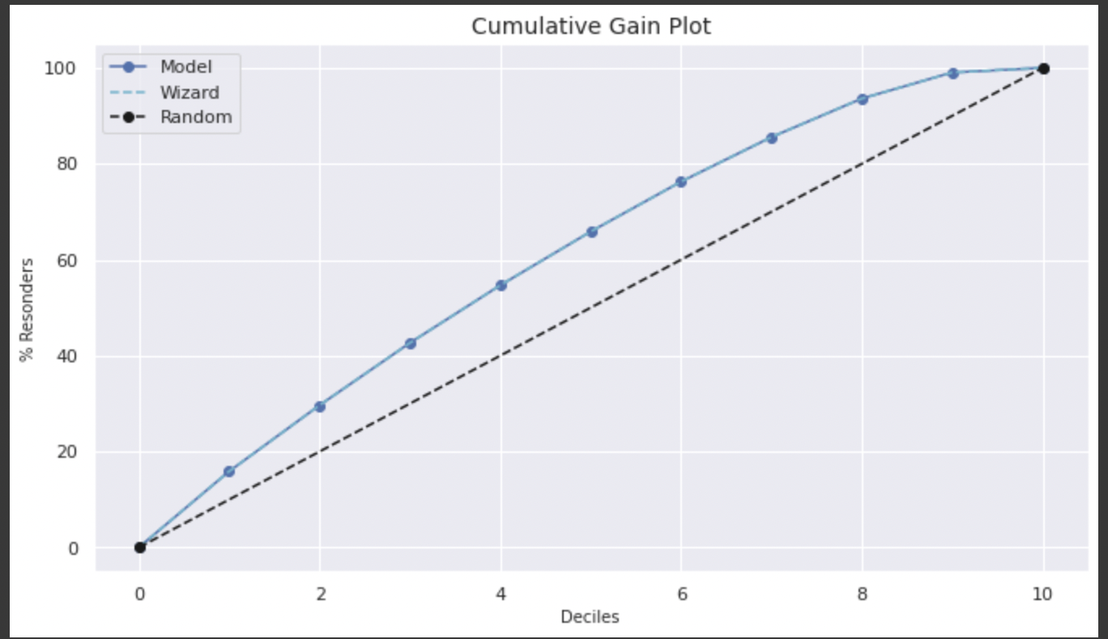
Random Forest

Slide 25
Project results and Insights
From the performance evaluation, we conclude that Linear Regression model suits best for this dataset to predict a song’s popularity using different features of the song
Using this prediction score is critical to build a recommendation system based on the features of the song and the user’s history
We propose to use this prediction score, the listener’s history and appropriate association rules, Collaborative filtering models to recommend songs to the listeners.
You can derive insights as to what makes a song popular and where the current trend in music is shifting to which can help businesses to make informed decisions

